Slide 1
Behavioural Modeling

Slide 2
Behavioural Modeling: Purpose
Describes the behaviour of the system as a whole and at subsystems level
  Is also known as dynamic model
Complements structural model
  Structural model defines the construct
  Behavioural model defines the ‘how’ in most cases
Notes:
Components, Entities, Services, Classes, Objects ...
Dependency, Generalization, Realization, Aggregation, Association
Component Relationship Diagram, Service Model, Entity Relationship Diagram, Class Diagram, Object Diagram ....

Slide 3

Behavioural Modeling: What is Behaviour?
How a system acts and reacts
We model behaviour at two levels
  End User
  Developer
    Intra Subsystem Level
    Inter Subsystem Level
    Object Level
Notes:
test

Slide 4
Behavioural Modeling : End User Level
Models the behaviour as it appears to the outside users
  Only the what not how
Represented using Use Case Diagram
  The context of the system
  The requirement of the system
  Shows a set of Use Cases and Actors and their relationships
    Generalization can be applied at Actor level
    Generalization and Composition can be applied for Use Cases
Notes:
test

Slide 5
Behavioural Modeling: Intra Subsystem Level
At the end of structural modelling we did
  Identify the subsystems ( e.g. classes )
  Specify the behaviour of the subsystems ( e.g. methods )
Intra subsystem level model details the complex behaviours ( e.g. method )
Uses flow chart or activity diagram or similar ...
Notes:
test

Slide 6
Behavioural Modeling : Inter Subsystem Level
At the end of structural Modelling we also
  Described the relationship between the subsystems ( component relationship diagram or class diagram )
Inter subsystem level Modelling concentrates on
  Detailing the implementation of the relationship
Relationship is captured by interaction models
Notes:
test

Slide 7
Behavioural Modeling : Inter Subsystem Level : Interaction Models
The main participants
  Objects - a particular instance as opposed to a class
  Attributes - properties of the class
  Methods - that can be invoked
  Messages - request an object to execute a method
Two types
  Ordered by time : Sequence Diagram
  Ordered by organization : Collaboration Diagram or Communication Diagram
Notes:
test

Slide 8
Behavioural Modeling : Inter Subsystem Level : Sequence Diagram
Identify the actor and the objects responsible
Create lifeline of each object
Add messages (include parameters, return values)
Maintain time sequence
How many diagrams?
  Significant use cases -- use case touching critical objects
  Generic scenario if applicable
    Persisting data
Notes:
test

Slide 9
Behavioural Modeling : Inter Subsystem Level : Collaboration Diagram
Emphasises on the organization of Objects
  As opposed to time sequence
Depicts the dependencies among the Objects
  Sort of Object Diagram showing message passing relationships
Good for visualising complex iteration, branching, multiple concurrent flows etc.
  Has not gained much popularity as it is not as programmer friendly as sequence diagram
It is sometimes called Communication Diagram
  https://www.uml-diagrams.org/communication-diagrams.html
Notes:
test

Slide 10
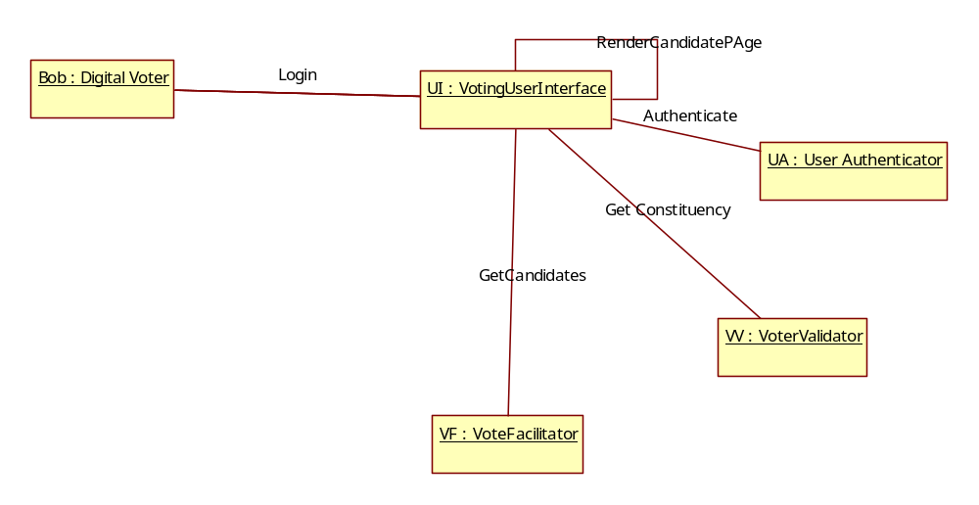
Behavioural Modeling : Inter Subsystem Level : Collaboration Diagram
Notes:
test

Slide 11
Behavioural Modeling : Object Level
Complex systems do have lot of reactive/passive objects
  Does not interact with other objects
  Has different states
    Transitions from one to other
  Always acted upon
    Typically, through events
  Monthly Consumption Bill, Order, Invoice etc.
Object level behaviour diagram is needed to model passive/reactive objects
Notes:
test

Slide 12
Behavioural Modeling : Object Level
Modelled as a state machine/diagram
  Specifies the sequences of states an Object goes through during its lifetime
Event triggers state change
  Specification of significant occurrence
State Machine Diagram - UML 2 Tutorial | Sparx Systems
Notes:
test

Slide 13
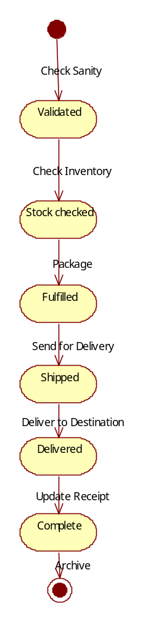
Behavioural Modeling : Object Level : State Machine-Order Example
Notes:
test

Slide 14
Behavioural Modeling -Applicability
System of Records
  Definitely yes
System of Engagements
  Probably yes unless there is some strong reason for not doing it
System of Insights
  Definitely yes
Notes:
test

